Slide 1
Managing POTUS Meeting Load:
What’s Working & January Focus
Recognizing strong scheduling performance while preparing for peak demand
January Operational Review

Slide 2
Strong Scheduling Performance
• High-volume POTUS meetings are scheduled with short lead times
• Large meetings do not create significant backlogs
• Performance remains strong despite rising volume

Slide 3
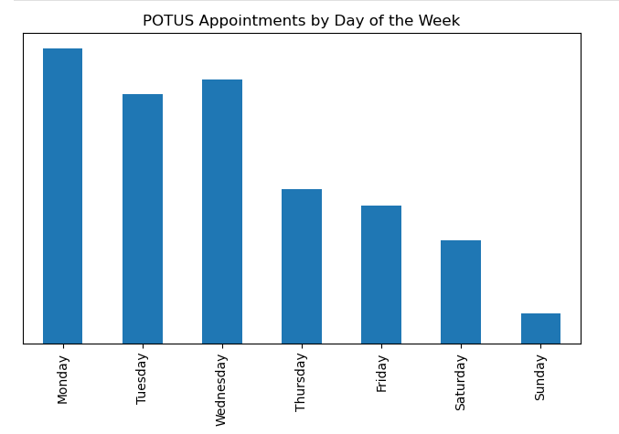
Keep Weekdays Available -> Be Prepared for High Volume Changes

Slide 4
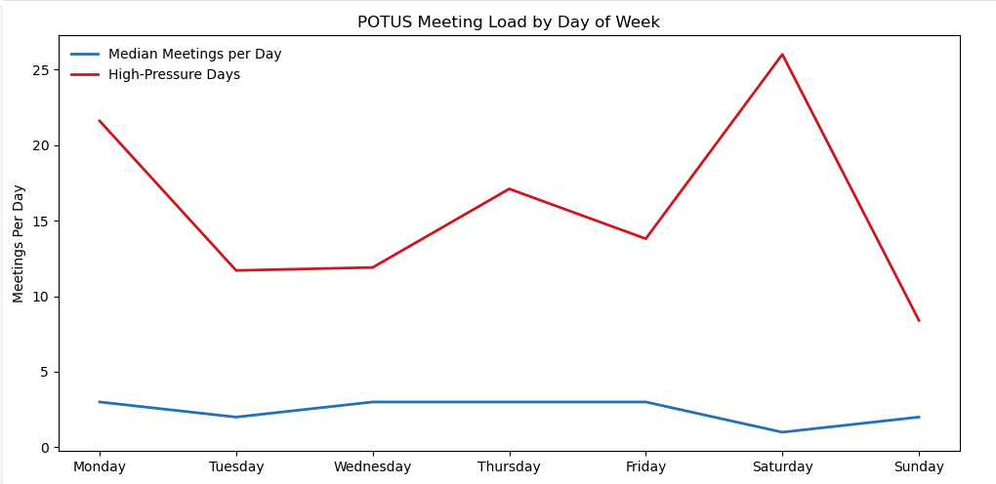
POTUS Meeting Load by Day of the Week

Slide 5
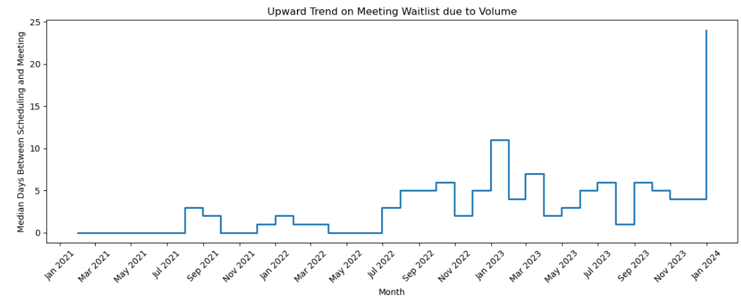
Wait Times are Trending Up with Volumes

Slide 6
Where Pressure Concentrates
• Mondays–Wednesdays carry the highest meeting load
• Saturdays see occasional spikes
• Sundays remain intentionally low-volume
Predictable patterns enable proactive planning

Slide 7
January Is a Strategic Opportunity
Volume increases mid-year and year-end
January starts lighter but ramps quickly
Early workload balancing prevents future bottlenecks

Slide 8
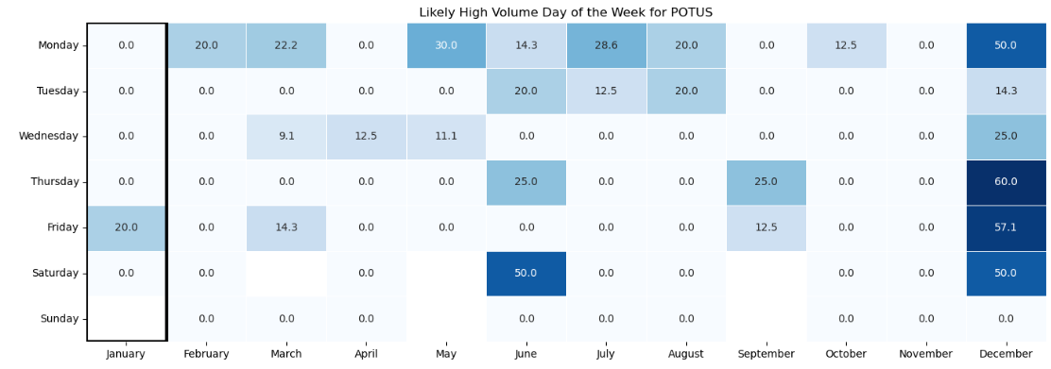
January Is a Strategic Opportunity

Slide 9
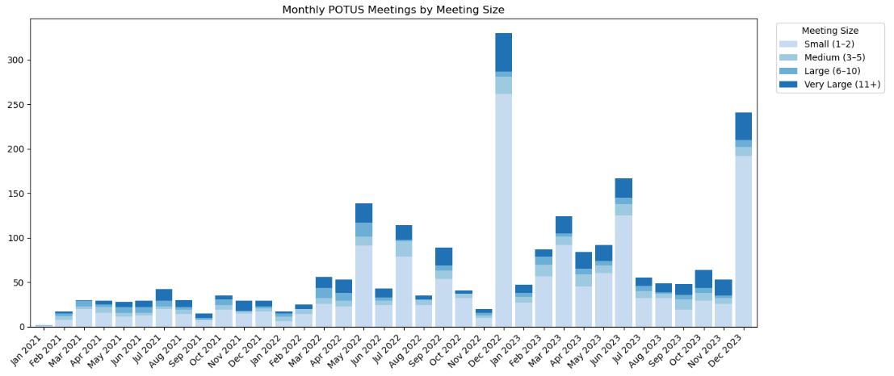
More Smaller Meetings = More Volume to Manage

Slide 10
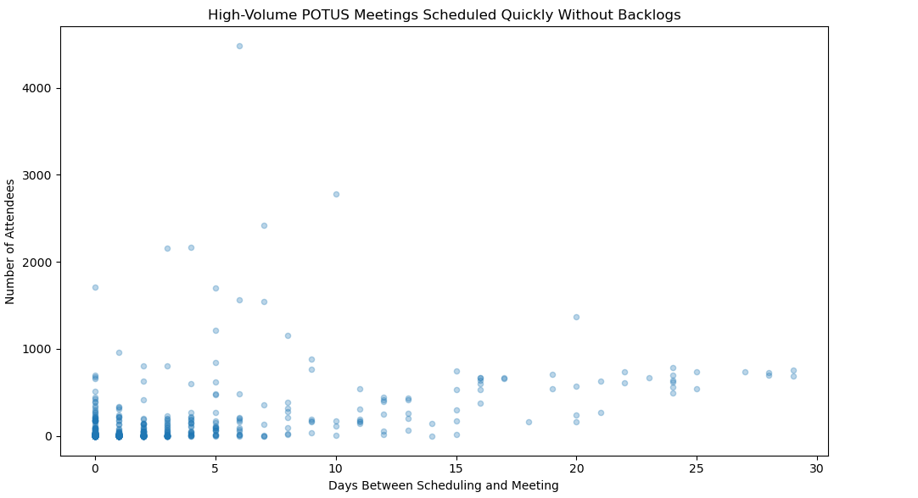
Great Job Meeting Demands with Little Backlog

Slide 11
Call to Action
• Spread flexible meetings across weekdays
• Flag high-volume meetings earlier
• Preserve buffers ahead of peak periods
• Continue effective prioritization practices
Strong performance today enables sustainable success

